Slide 1
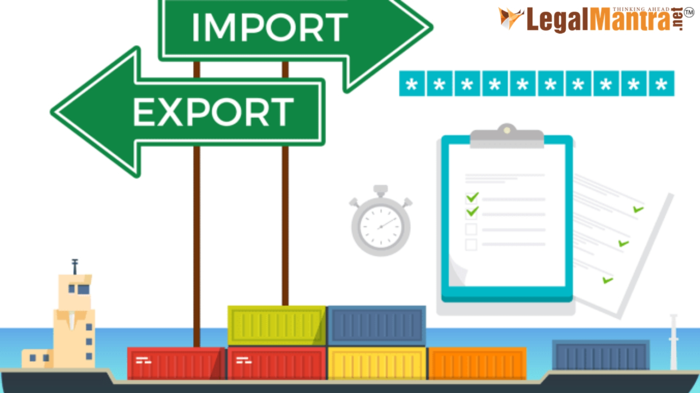

Slide 2
Import Export Procedure

Slide 3
The import export procedure is a systematic business procedure that is to be followed for gaining creditworthiness in the international market. Without proper export and import procedure, the movement or transport of goods from one country to another (and vice versa) is not possible. Very few import export institutes in India help the candidates to gain systematic and basic procedure. Remember, the basics of the export import process are very important to learn. Once you hold the import export basic knowledge and expertise for the import export business along with the understanding of the product exporting process, you can gain easy and effortless success in the field with import trade as well as export trade (import and export trade).

Slide 4
Documentation Process
The first most important thing is deciding upon the brand name or the entity.
Have you come up with an idea of naming your import export brand for all the future trade and services that you are going to exercise under a legal entity? We always advise our candidates to keep the import export brand as a separate brand from their ongoing businesses to have ease in customs and other import export procedure. Well, the first import and export process is to establish a brand name or a legal entity for running the import export business.
IEC registration process – IEC license
Applying for the import export code is very important for initiating every trade under your import export entity. To register for the IEC (Import Export Code), you need to visit https://online-iec.org. This is an Indian government website that helps import export business owners to get their IEC registration process online. It is a very simple procedure and hardly takes 10-15 days to get your IEC license via email. A Pan number is a must to have for completing the IEC registration process. So here’s a tip, first register or acquire the PAN details of your legal entity before applying for the IEC license.

Slide 5
WHAT IS IMPORT AND EXPORT PROCEDURES
Understanding the export process is the first step of your import export business success. There is a huge craze for imported brands in our country, India. Indians use imported mobile phones, cosmetics, clothes, shoes, watches, accessories, laptops, furniture, crockery, etc. to name a few. Investing your time and money in the import business in India will be worth looking at the growing demands of Indians for imported brands and goods. Here, we shall discuss the import procedure first to understand how to start the import business in India.

Slide 6
IMPORT CYCLE FOR THE ENTREPRENEURS
1: Product selection
To move ahead with the right product for gaining maximum profit, you must learn to select the product in the most appropriate way. If you are confused with the product selection, here is one tip – go for the product that has great demand in the Indian market. Consider the future demand research too before finalizing any product for the import business in India.
2: Identification of the supplier country
Once you decide on the product, it is vital to understand and research the countries that export a particular product. You have to be very wise in deciding the country by comparing the rates, the benefits, the quality, etc. So, the second process is choosing the best exporter country that can help you gain maximum advantage from the trade.

Slide 7
3: Selection of the best supplier
As an importer, you can always ask for the sample from various exporters to help you verify the quality compared to the rate demanded. This is an important export import procedure for the importer cycle.
4: Payment terms & Negotiation
The most important process of import and export is Payment and negotiation which involves the final deal between the buyer and the supplier. As an importer, you have the right to ask for a negotiable price on the said product quality. You have to also discuss the import duties of the particular product. We always ask the importer to consider a fair deal agreement where both parties share equal risk.

Slide 8
5: Issuing Purchase Order as per the deal
The importer has to send the purchase order to the exporter by providing complete details of the goods to be imported with a detailed description mentioning the quantity, rate discussed, and product quality type (if necessary).
6: Hiring CHA
The set of O’rear documents are handed over to the appointed CHA for the receipt of goods at the incoming port of destination. The role of CHA is very important in the export import procedure. The importer has to pay import duty to CHA for the goods clearance. A Customs House Agent will help the importer to receive the goods at the port with the legal customs clearance process. In India, the import procedure of receiving goods is carried out at both port and ICD. Later, the importer will have its goods delivered to the warehouse by the CHA.As an importer, you will always make the decision to help your goods to reach the warehouse by your preferred transport method (via rail, road, or air).

Slide 9
7: Product Distribution
The last procedure is for the importer to distribute the product to the said retailers or distributions, where he has already imitated a deal of agreement for the sale of imported items.

Slide 10
THANK YOU

